Slide 1
Working in Harmony with Non-archivists as Collaborators:
Case Studies from Music Repositories
Panelists:
Brendan Higgins- The Boston Conservatory
Sarah Funke Donovan - Boston Symphony Orchestra Archives
Paul Engle & Sofía Becerra-Licha - Berklee College of Music

Slide 2
Outreach for Survival
Creative Collaboration with The Boston Conservatory Archives
Presented by Brendan Higgins
New England Archivist’s Spring Meeting
Portsmouth, NH. March 22, 2014

Slide 3
Outreach for Survival
Collaborating with:
Librarians
Marketing and Advancement Offices
Individual Schools/Departments

Slide 4
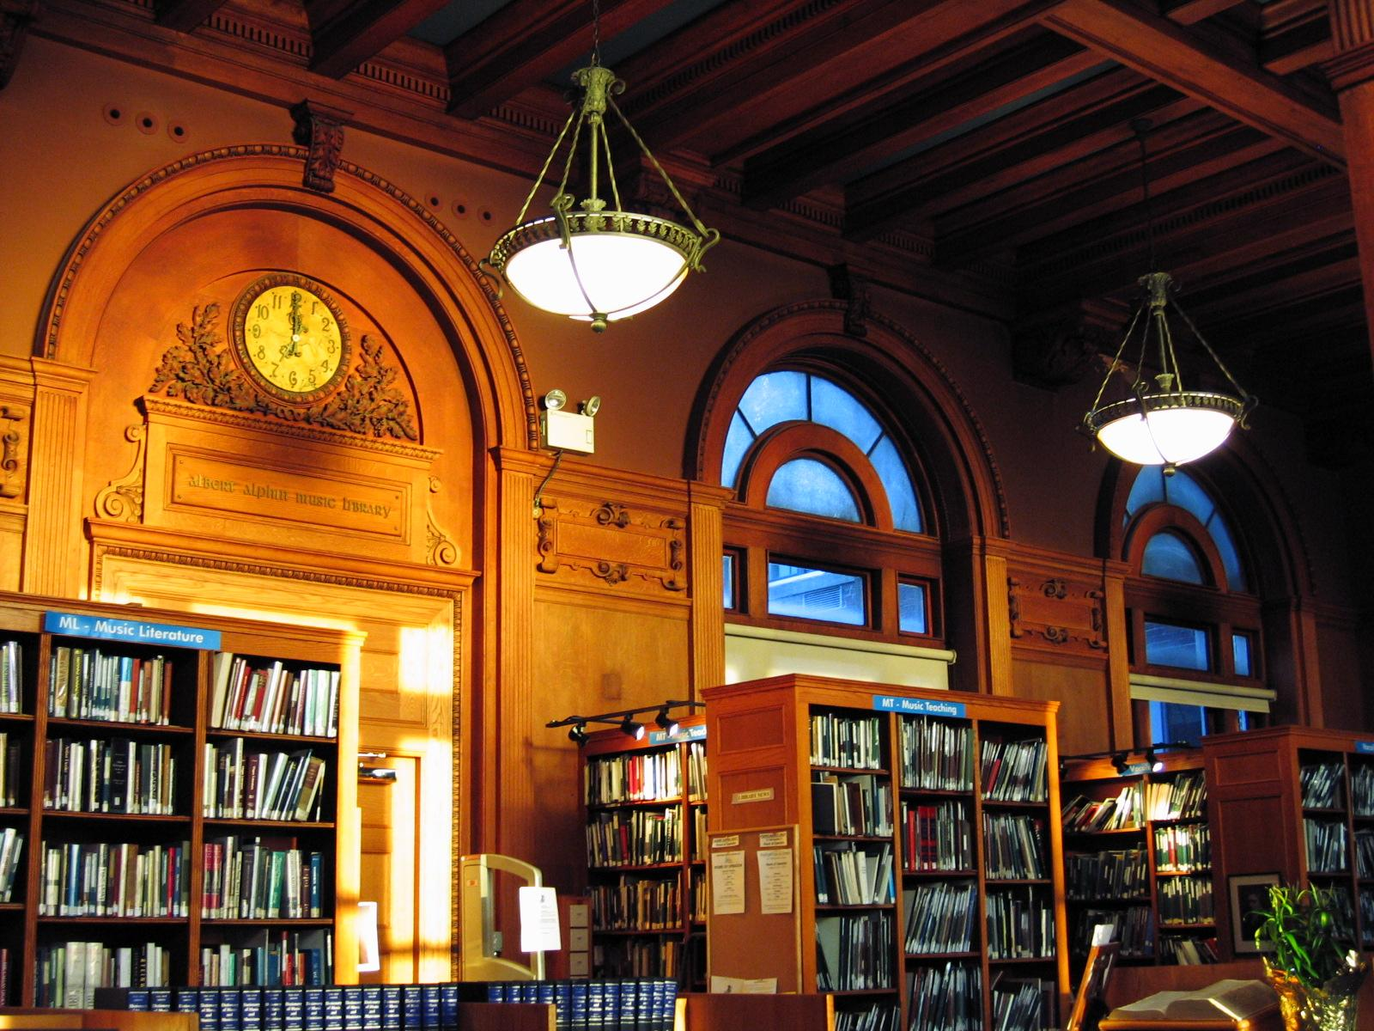
Boston Conservatory Archives

Slide 5
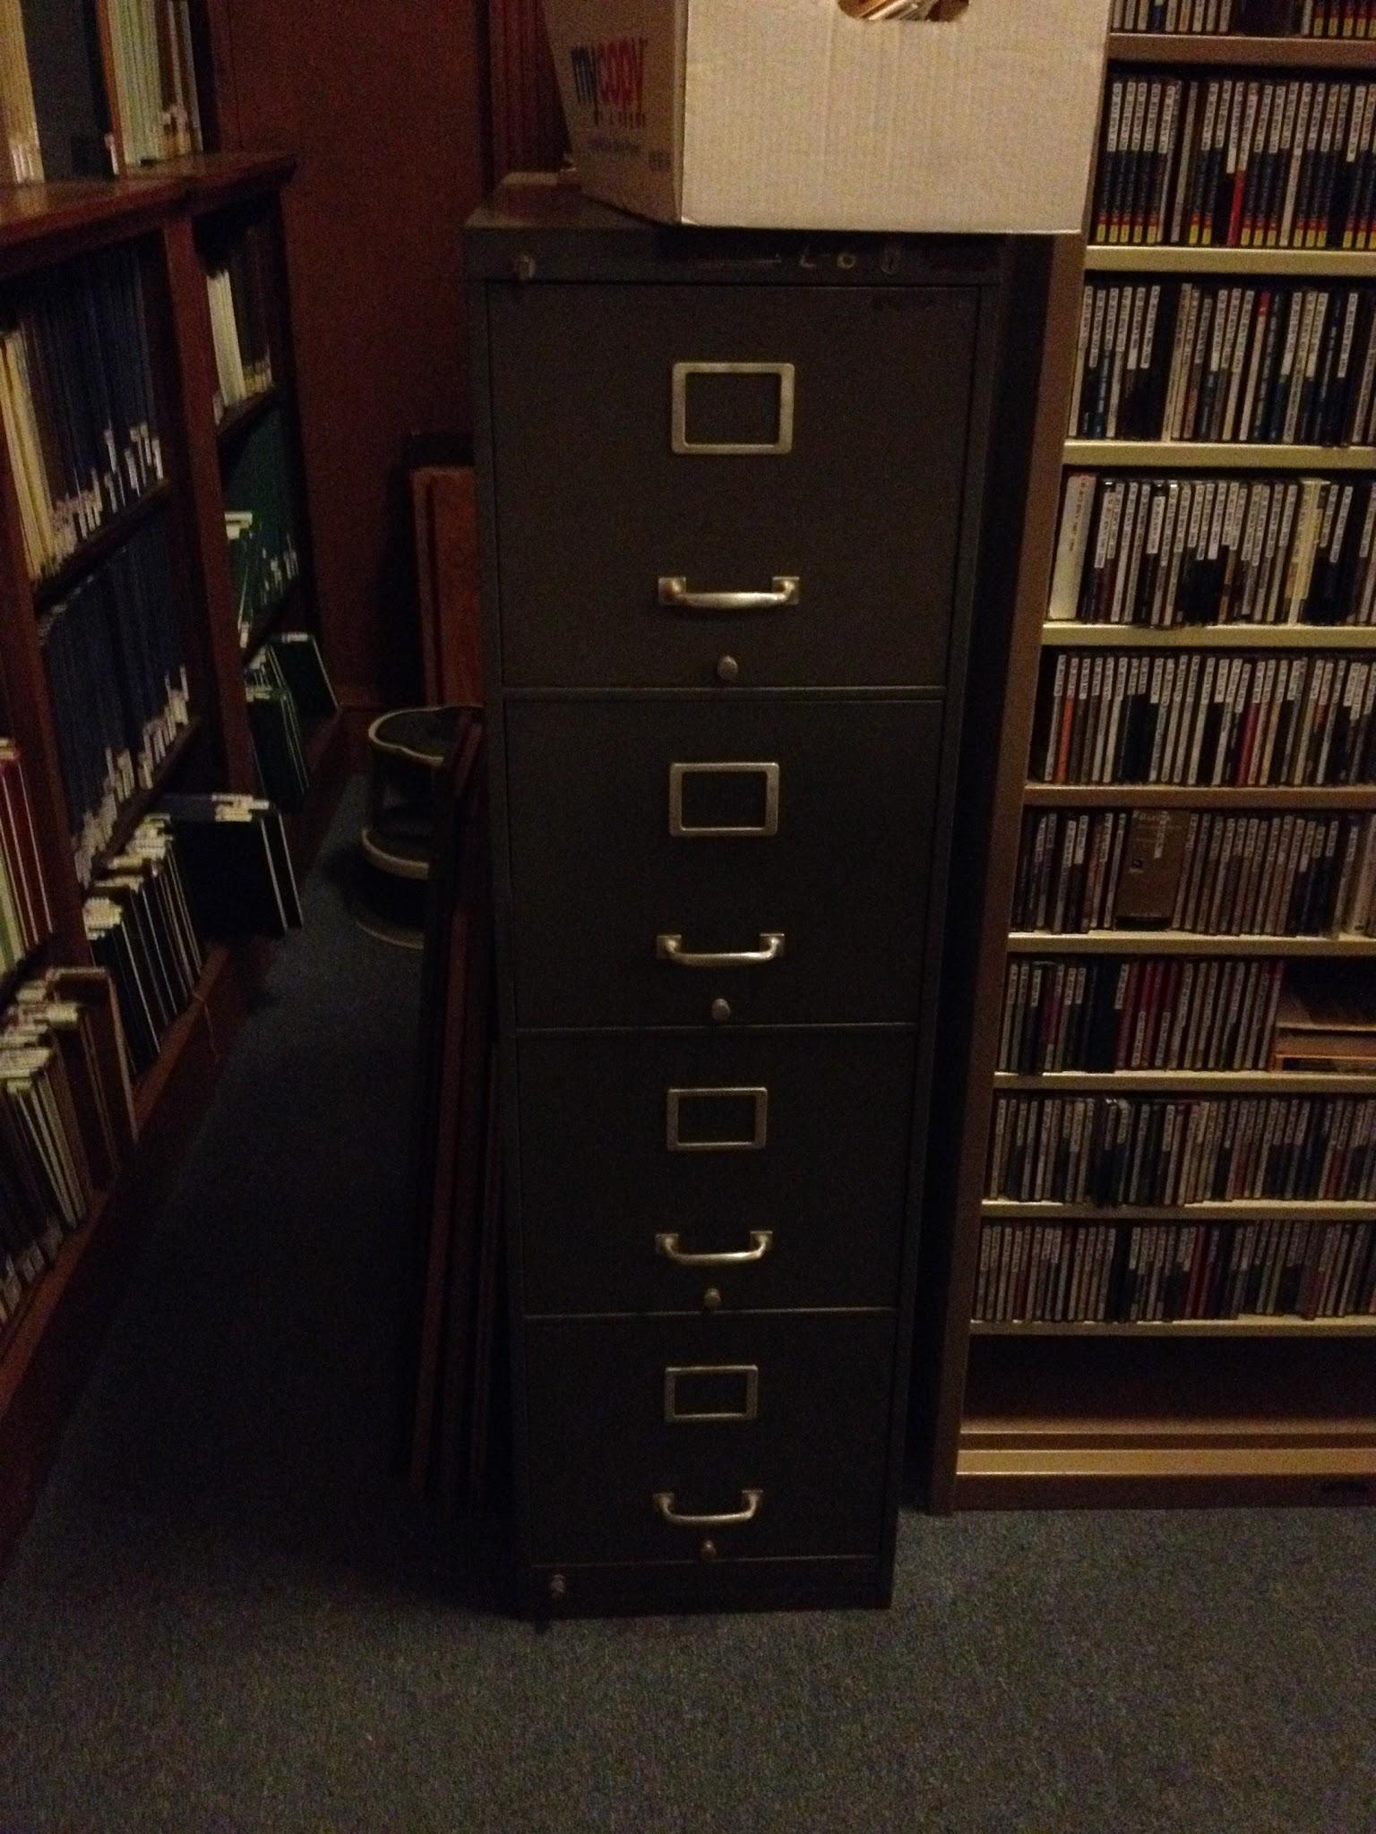
Current state of the archives
One finding aid
One filing cabinet
Materials scattered in library and on campus
Preservation concerns
No funding, no archivist
NHPRC Grant pending

Slide 6
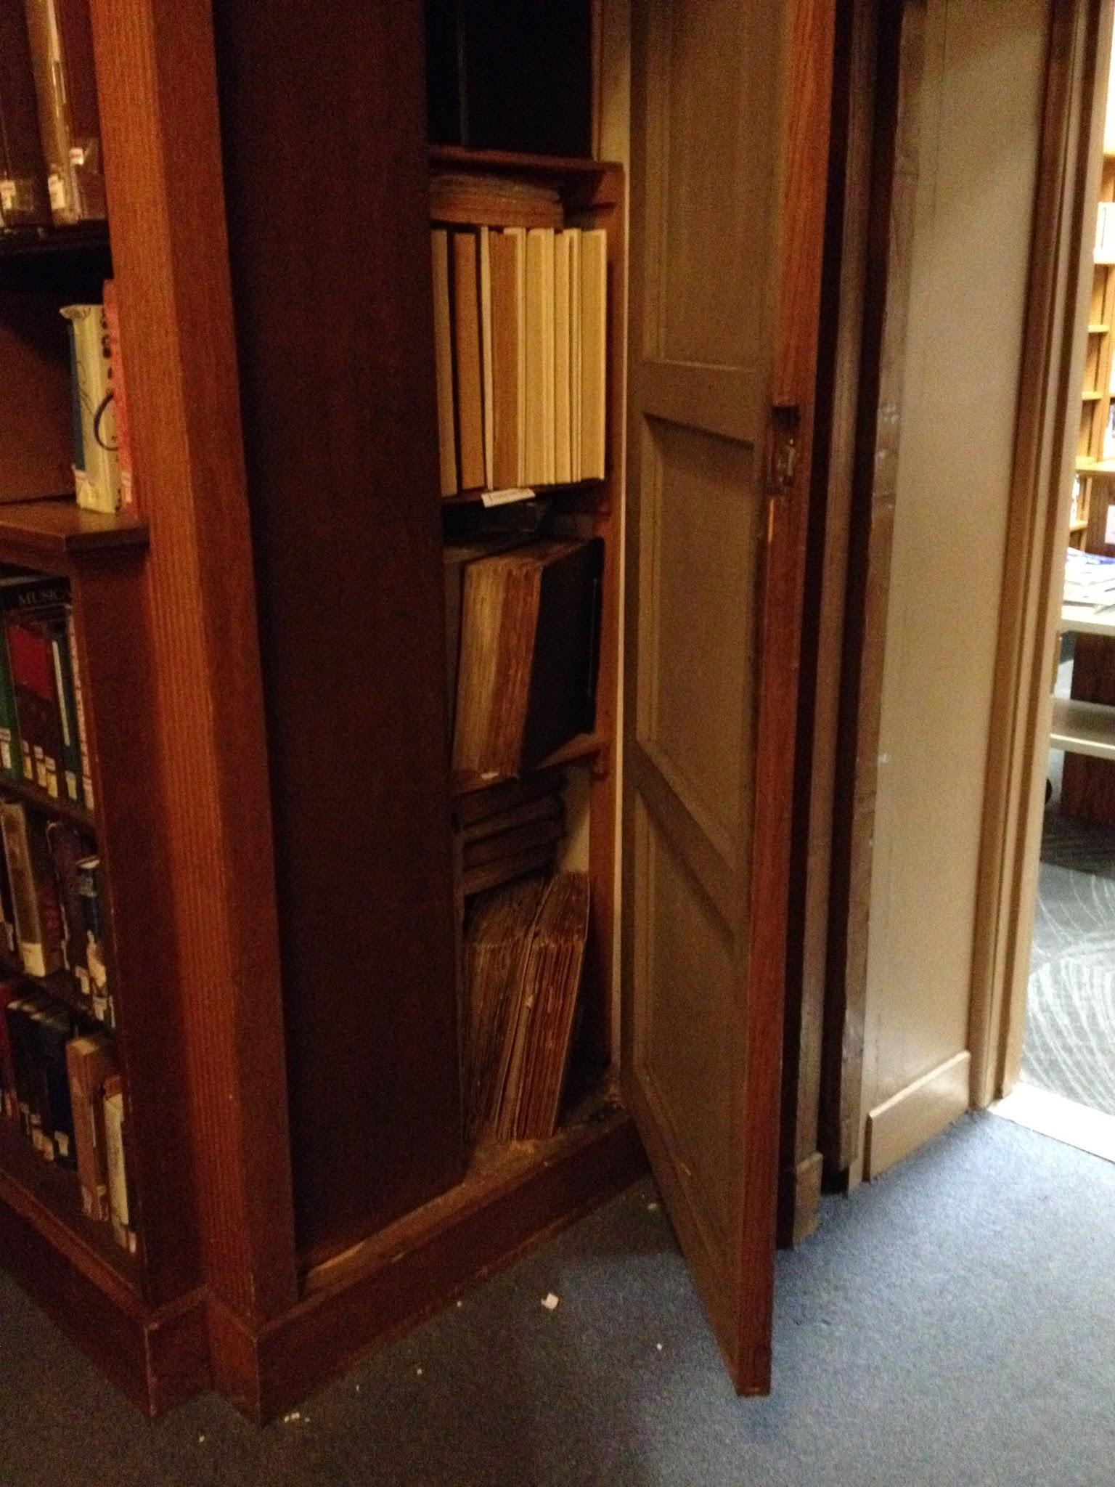
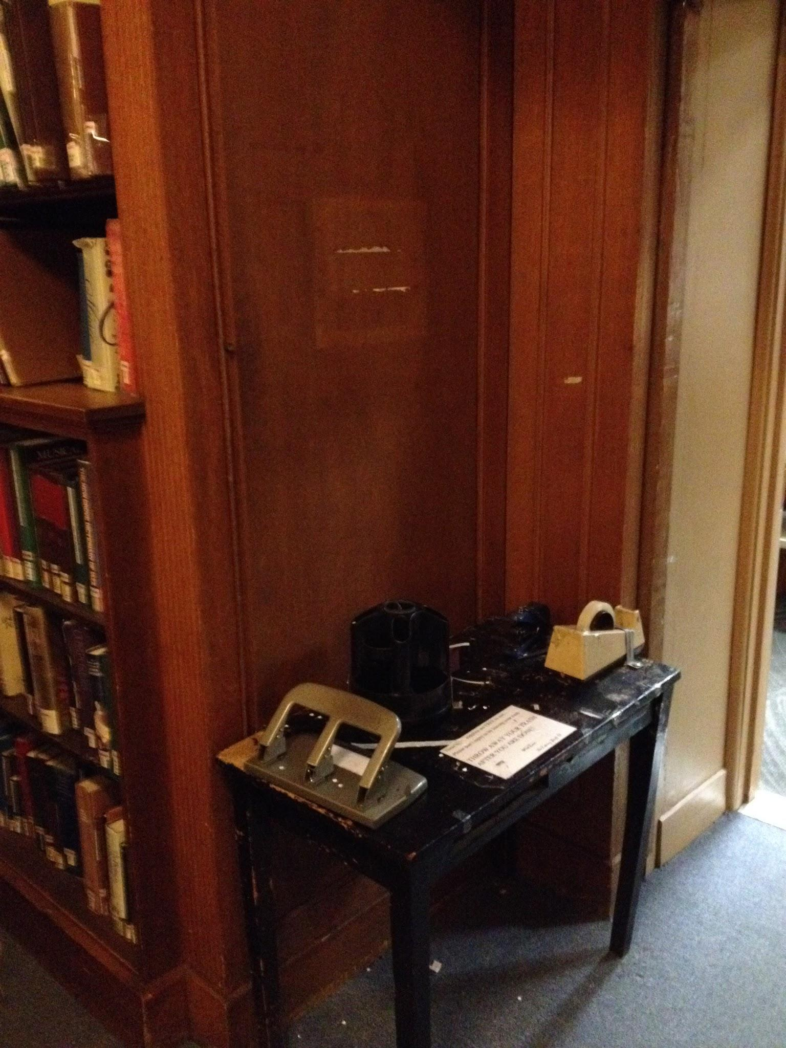
Current state of the archives

Slide 7
Collaboration with Librarians
Why would a librarian need to think like an archivist?
Appraisal of donations
Librarians only see what is valuable to the library
Don’t apply archival theory - respect des fonds and original order
Value functionality of an item over its possible contextual value
Acquisitions
Lack understanding of what the archives collects
Don’t consider documenting provenance or even date of acquisition

Slide 8
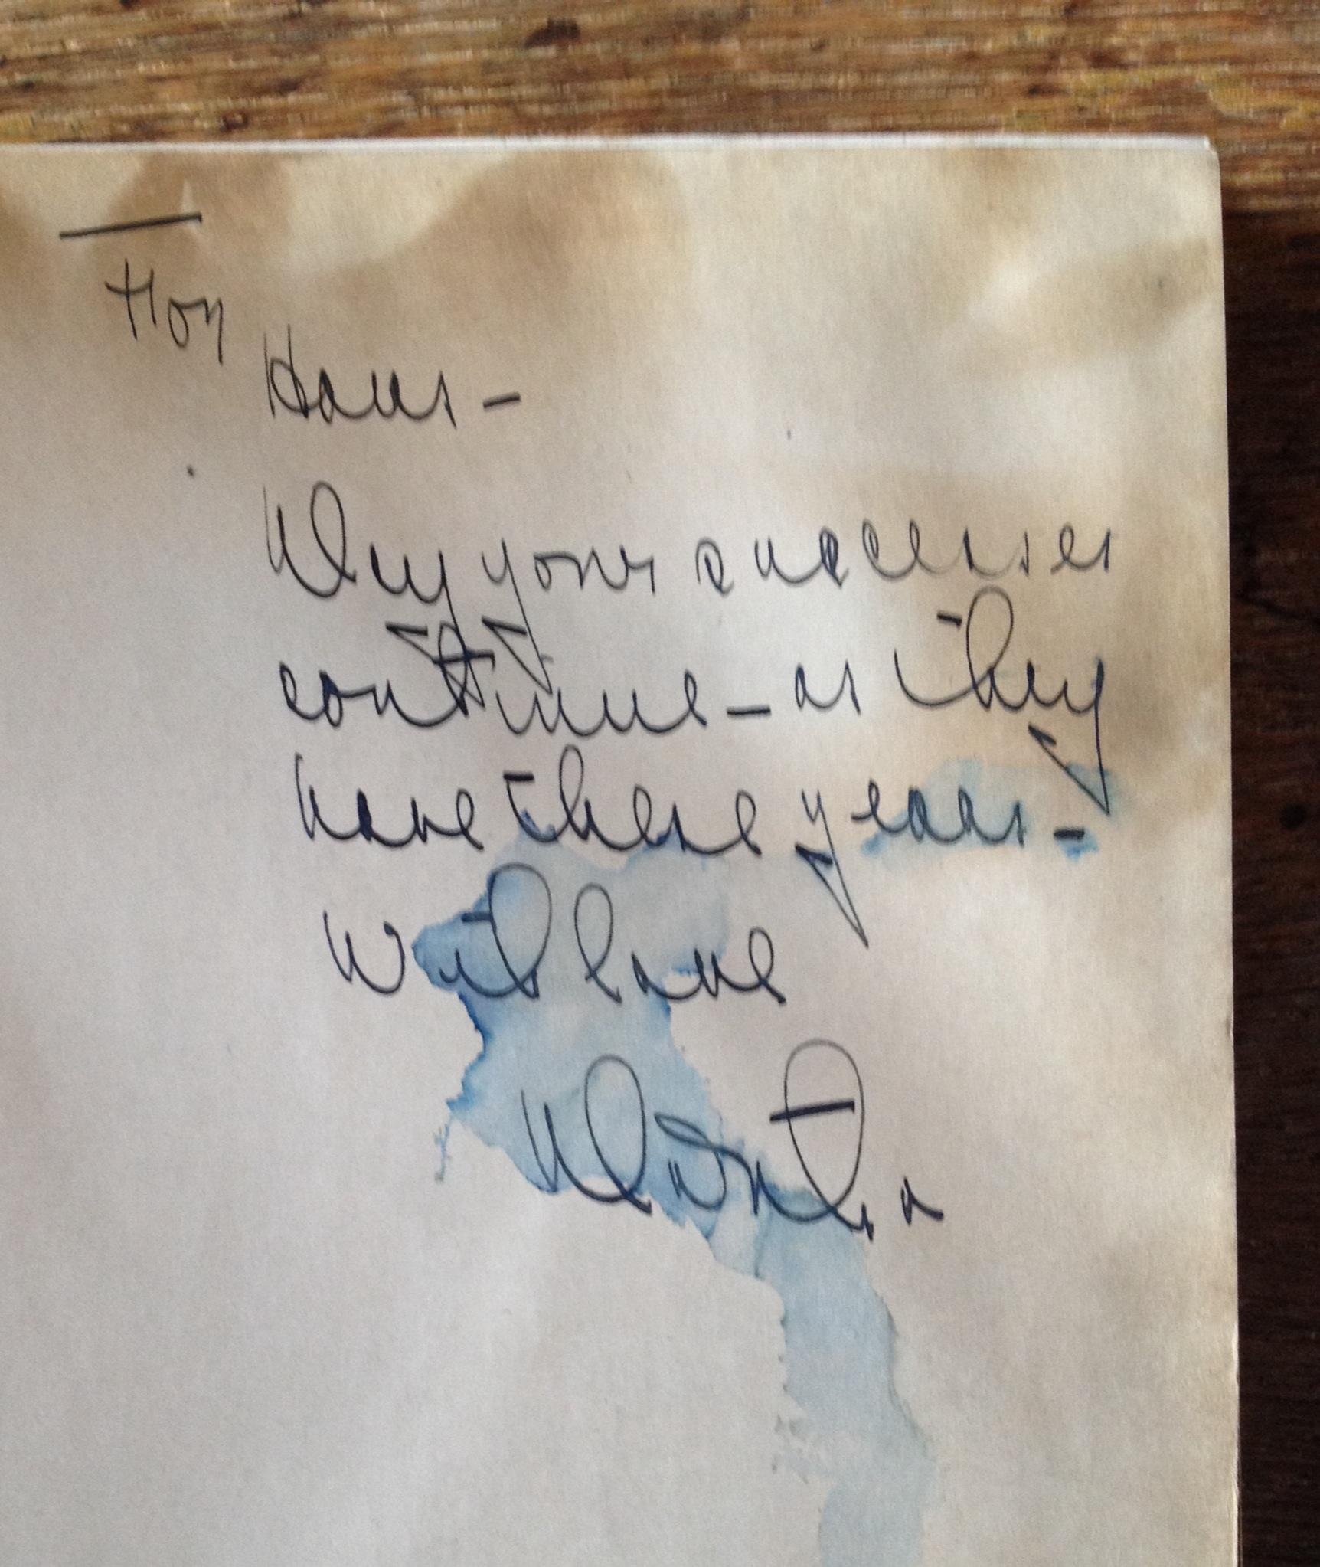
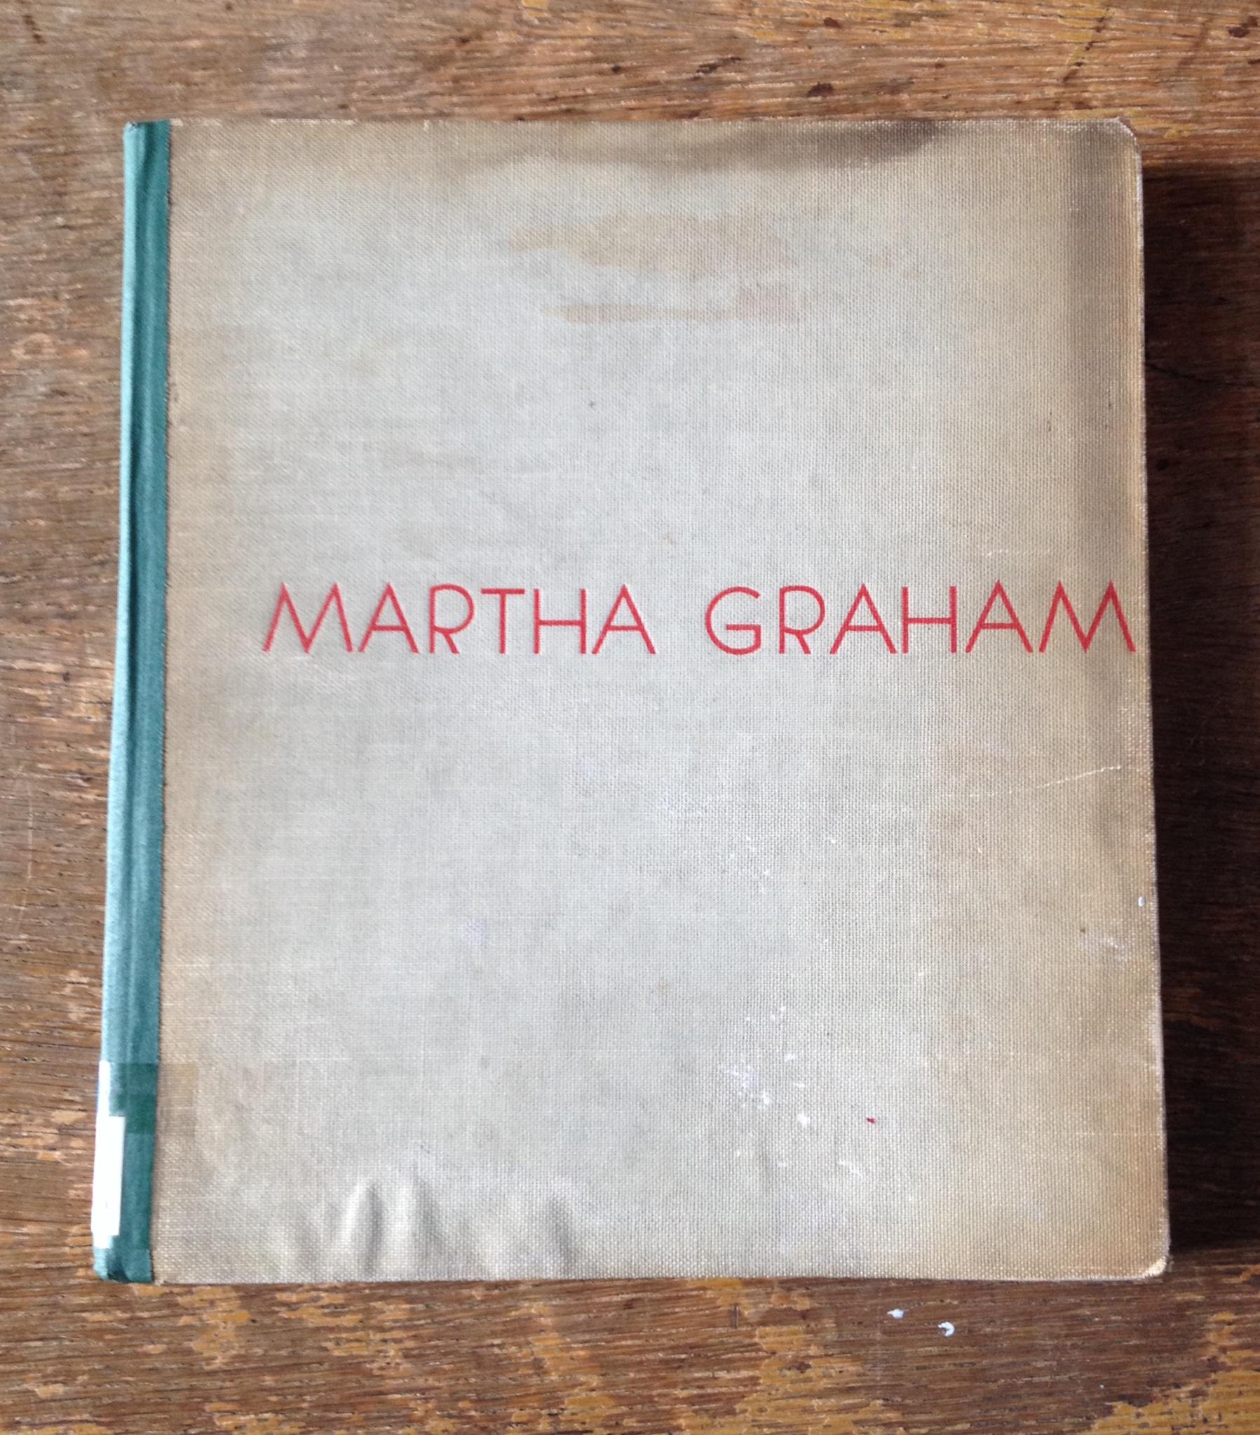
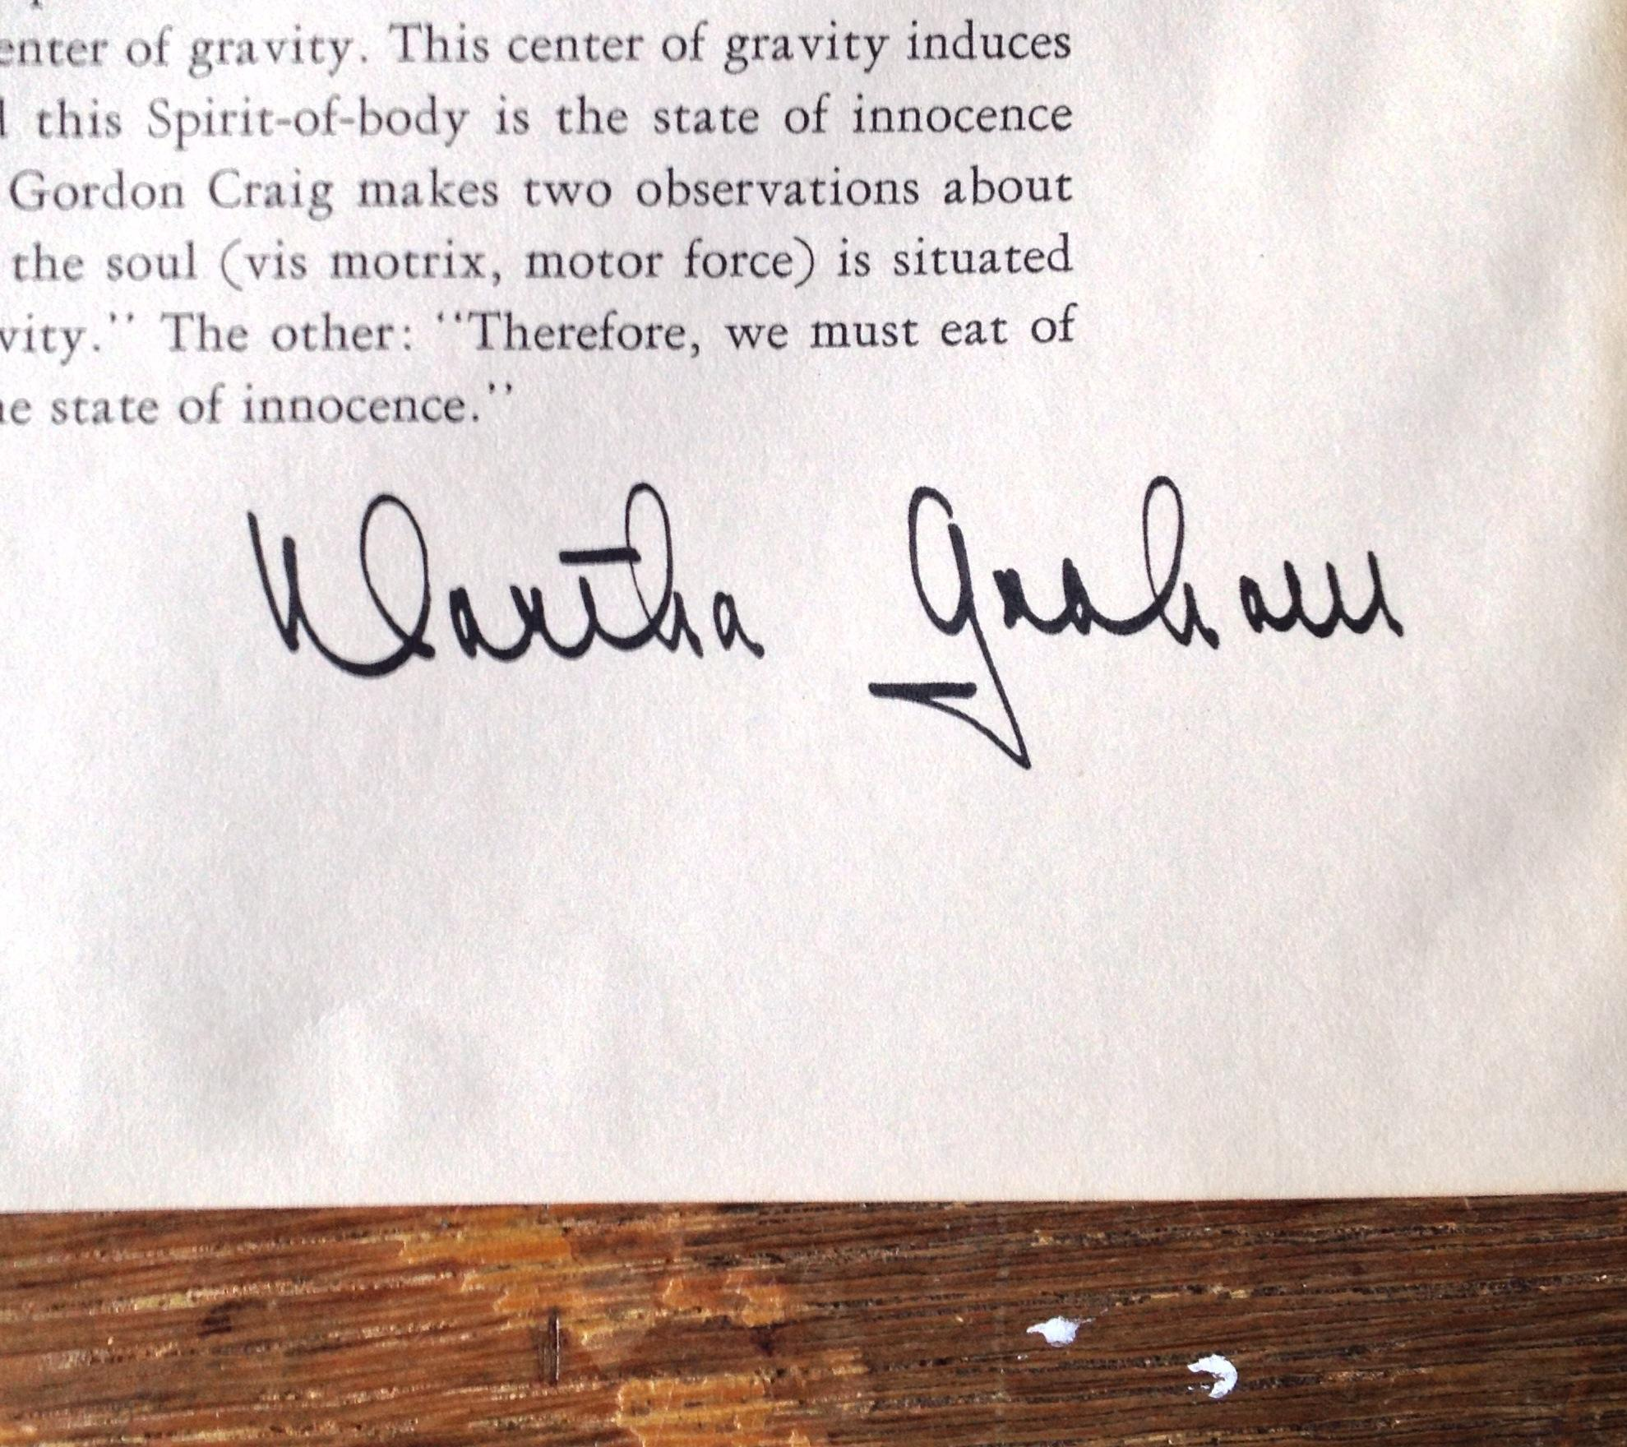
Collaboration with Librarians

Slide 9
Collaboration with Librarians
Solution- Maintain the discussion with librarians
Explain core principles of archival theory and its applicability
Properly assess donations
Teach librarians what to look for and to know when to contact the archivist
Document acquisitions appropriately

Slide 10
Collaboration with Advancement Office
“We have an archive?”
Their lack of knowledge about the collection
High turnover and little precedence for collaboration
More acquisitions issues
Walking a fine line with collaboration
Enough promotion of the current collection without encouraging a records dump (with nowhere to put it)
Keep contact, especially in institutions with turnover issues

Slide 11
Collaboration with Schools/Departments
Composition Department Digital Repository
To complement archived recordings, 30 concerts a year
PDF copy of score held in repository
Linked to MARC record of CD
Metadata specifications
Composer, date completed, date performed, instrumentation, genre(?)

Slide 12
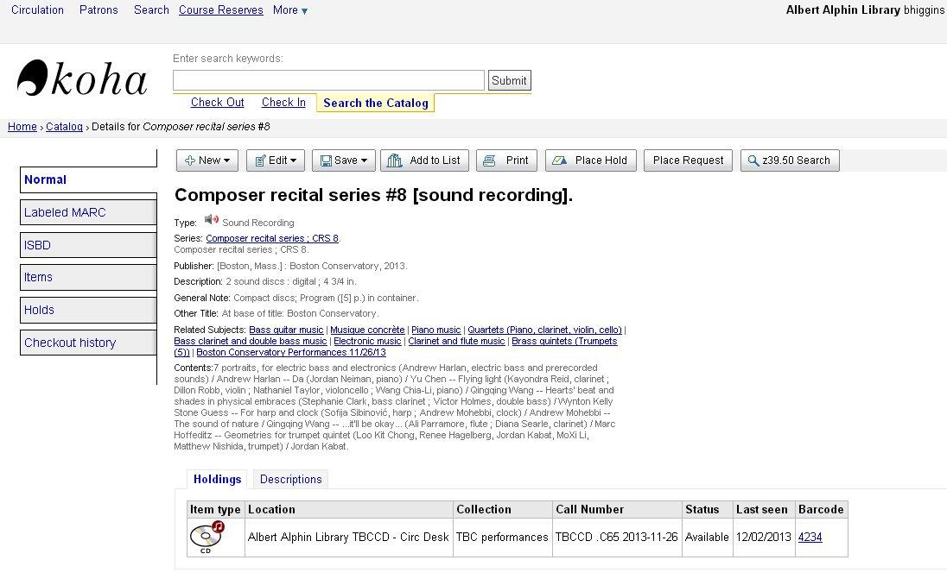
Collaboration with Schools/Departments

Slide 13
Collaboration with Schools/Departments
Collaborate with faculty
- Communicate with students about delivering scores and advocating for the program
Collaborate with students
- Timely delivery and ingest of scores, preferred metadata, discuss copyright and access restrictions
Collaborate with IT
- Build database, provide server space, help define metadata, access restrictions

Slide 14
Conclusions
Reinforce importance of archival perspective to librarians
Maintain a constant contact with advancement and marketing
Get creative with the collection and talk to other departments
There are always new collaborative projects to be explored

